Slide 1
Shortness of Breath
Kai Ping Wang, MD PGY3, Dr. Nathan Mclaughlin, MD

Slide 2
Chief Complaint
78 year old woman with history of well controlled DM2, HTN, physical deconditioning, iron deficiency anemia, and mild intermittent asthma, presenting to the ED for SOB x3 days and chest pain.

Slide 3
Differentials?

Slide 4
More History
Per patient, asthma seems to always get worse “when the weather is bad”
Shortness of breath is worsened with exertion and her home inhalers (Advair for controller, albuterol prn) have not helped her.
SOB associated with chest pain, worsened with movement and inspiration. Chest pain is 3/10 without radiation and described as dull.
No recent changes to medications, has not missed medications per patient

Slide 5
Social History
Tobacco: Never
Alcohol: 0.6oz per week
No illicit drug use
Lives at home with her son who is her primary caregiver. At baseline has difficulty with mobility due to physical deconditioning requiring FWW, has shuffling/unsteady gait. Sedentary and stays in her room watching television most of the day.

Slide 6
Medications
DM2: Metformin 500mg BID, Lantus 15u QHS
HTN: Amlodipine 5mg qd, Benazepril 10mg qd, daily ASA
Chronic Knee Pain: Lidoderm patch
Mild Intermittent Asthma vs COPD: Advair BID, Albuterol q6hr prn

Slide 7
ED Course: Vital Signs
@0001
BP: 180/103
Pulse: 89
Temp: 97.9F
RR: 22
SpO2: 94% room air
@0201
BP: 129/80
Pulse: 82
Temp: NA
RR: 22
SpO2: 91% 4L NC
@0401
BP: 159/95
Pulse: 78
Temp: NA
RR: 21
SpO2: 98% 4L NC
@0205 Received 5mg Albuterol, Atrovent, and Dexamethasone

Slide 8
ED Course: Initial Exam

Slide 9
What do you want to Know/Order?

Slide 10
ED Course: Labs/Imaging
Na: 139
K: grossly hemolyzed (Repeat 3.9)
Cl: 109
CO2: 20 L
BUN: 18
Creat: 1.06 H
Glu:
Mg: 2.0
Phos: 3.2
WBC: 8.5
Hgb: 10.5 L
Hct: 34.0 L
MCV: 75.3 L
PLT: 209
ProBNP: 11,056 H
CKMB: 1.8
Troponin: <0.015

Slide 11
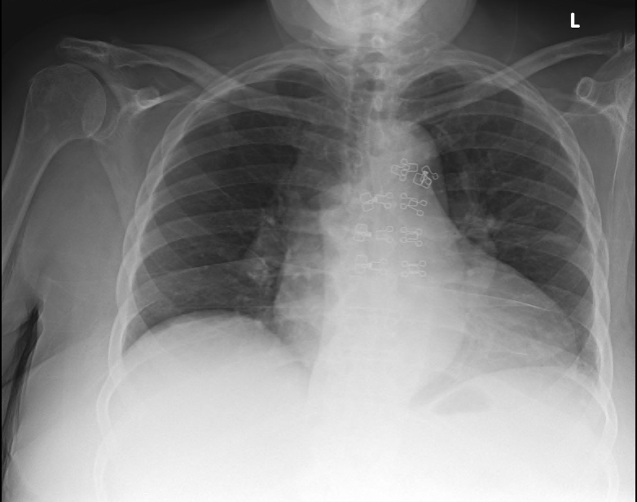
Notes:
Findings: mild left basilar discoid atelectasis. Heart size is within normal limits. There is no pleural effusion. No pneumothorax identified. Degenerative spurring

Slide 12
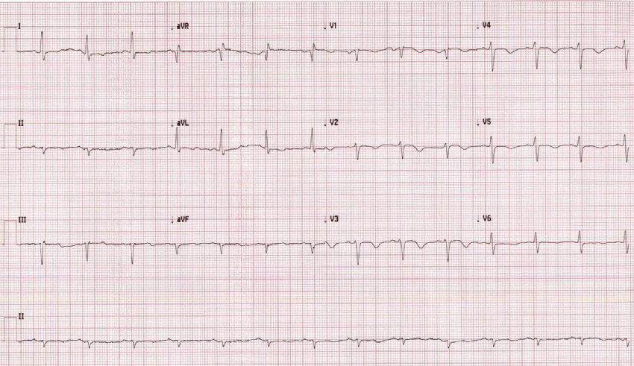
ED Course: Labs/Imaging
Notes:
Left anterior fascicular block, Sinus rhythm, ST changes nonspecific and T wave inversions

Slide 13
ED Course: Assessment
In the ED received aspirin 324mg x1, FM called for admission for ACS vs Asthma exacerbation, initial exam with FM @0413

Slide 14
Overnight Team Physical Exam:

Slide 15
Summary
78 year old woman with history of well controlled DM2, HTN, physical deconditioning, iron deficiency anemia, and mild intermittent asthma, presenting to the ED for SOB x3 days and chest pain.
Received breathing treatments in ED, however still with increasing oxygen need, on 3-4L NC at 98%, mildly tachypneic 21-22
Labs significant for stable microcytic anemia, mild elevation of creatinine 1.06, normal initial troponin I, and elevated ProBNP: 11,056 H
EKG significant for Left fascicular block with T wave inversions in multiple leads, S1Q3T3
CXR: Mild left basilar atelectasis, no effusion

Slide 16
Differentials?

Slide 17
Differentials?

Slide 18
Day Team Assessment:
D-dimer 16.14 H
Influenza A, B antigen negative
Troponin negative x2

Slide 19
CT Angio

Slide 20
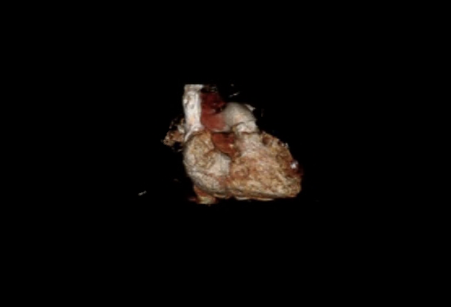

Slide 22
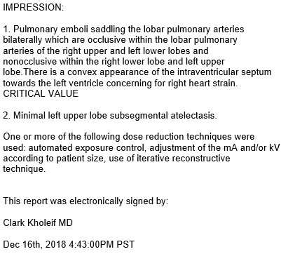

Slide 23
Pulmonology Consult @1612
Physical exam significant for lungs clear to auscultation, A&Ox3
POCUS:
Enlarged RV and RA. Evidence of mild RV strain with septal flattening
IVC dilated but non collapsible
No visible clots in both femoral veins

Slide 24
Pulmonology Consult @1612

Slide 25
Echocardiogram 12/16/2018

Slide 26
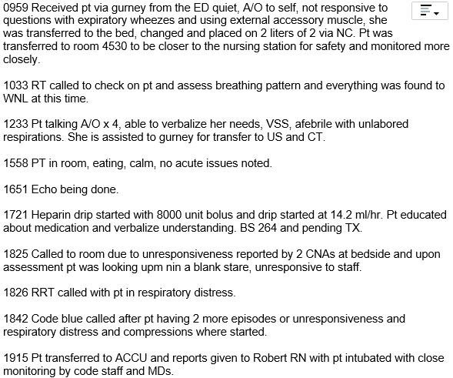

Slide 27
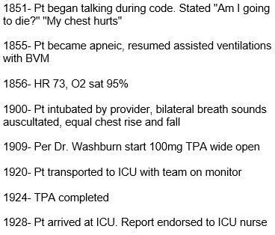

Slide 28
Hospital Course
Patient coded twice, with achievement of ROSC. tPA given during second code and patient was intubated and transferred to MICU. Required Levophed to maintain pressures, but was able to be weaned by 12/19
Massive PE with Heparin drip continued, ultrasound lower extremities found to have left common femoral DVT

Slide 29
Hospital Course
Found to have vaginal bleeding on chucks during MICU stay, found to have pelvic mass on ultrasound and CT A&P, concern for malignancy, plan to transition to Lovenox if confirmed malignancy
Downgraded to FM on 12/19/18 on 3L NC
Biopsy performed on 12/24/18 confirmed adenocarcinoma of likely endocervical origin
Discharged to Cypress Gardens SNF with Lovenox

Slide 30
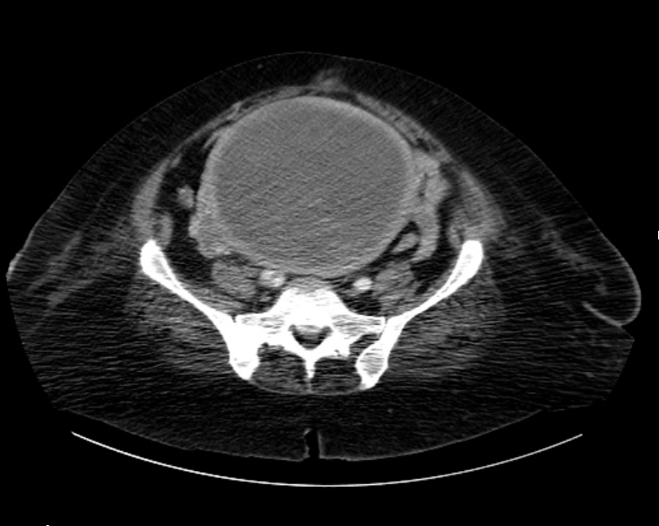
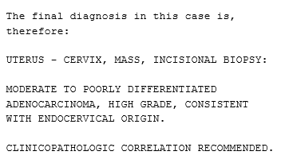
Pathology Report 12/24/18

Slide 31
Pulmonary Embolism
A form of venous thromboembolism that is common and sometimes fatal.
Clinical presentation of a PE is often non specific
Defined as obstruction of the pulmonary artery or its branche
Notes:
Evaluation should be efficient so that therapy can be administered quickly to prevent associated morbidity/mortality
thrombus/tumor/air/fat originating elsewhere in the body.

Slide 32
Pulmonary Embolism
Temporal Pattern of Presentation:
Acute: Acute PE typically develop symptoms and signs immediately after obstruction
Subacute: Within days or weeks
Chronic: Develop symptoms of pulmonary HTN over many years
Presence or Absence of Hemodynamic Stability:
Hemodynamically unstable PE is defined as a massive or high risk PE, whereas submassive PE is hemodynamically stable with some right heart strain

Slide 33
Epidemiology
Overall incidence is higher in males compared with females (56 versus 48 per 100,000)
Incidence rises with increasing age, particularly in women
Risk Factors: Similar to those of Venous thromboembolism
Acquired risk factors can be sub-classified as provoking or non-provoking
Notes:
Provoking: recent surgery, trauma, immobilization, initiation of hormone therapy, active cancer
Nonprovoking: obesity, heavy cigarette smoking

Slide 34
Diagnosis:
Well’s Criteria | Score
Clinical Symptoms of DVT | 3.0
Other diagnosis less likely than PE | 3.0
Heart rate >100 | 1.5
Immobilization >3 days or surgery in past 4 weeks | 1.5
Previous DVT/PE | 1.5
Hemoptysis | 1.0
Malignancy | 1.0
Scoring:
High: >6.0
Moderate: 2.0-6.0
Low: <2.0
Notes:
Due to varying range of presentations, important to risk stratify patients for further assessment.

Slide 35
What was our patient’s Well’s Score?
Notes:
4.5 based on likely diagnosis and immobilization

Slide 36
Diagnosis
Depending on Well’s Score, determines algorithm for evaluation.
Low Risk: Can rule out with PERC rule in the ED, or if clinical suspicion is there can order D-dimer
Medium Risk: Similar to low risk but you go straight to D-dimer
High Risk: Order CT aniogogram Chest or V/Q scan
Notes:
Age >50, Tachycardia >100, O2 sat on room air <95%, unilateral leg swelling, hemoptysis, recent surgery/trauma, prior PE/DVT, hormone use. If negative can rule out. Useful only in ED setting

Slide 37
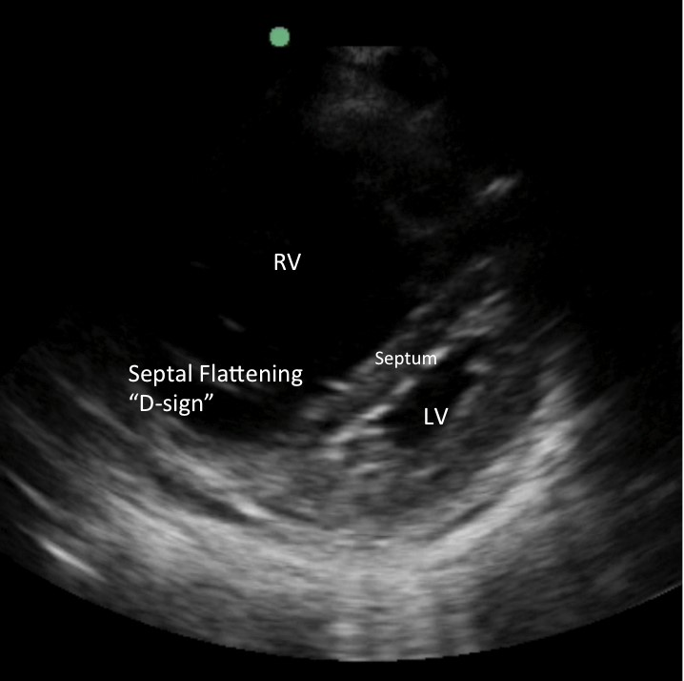
Diagnosis
For Hemodynamically unstable patients, bedside echo or venous compression ultrasound may be used to obtain justification for administration of lifesaving treatment
Increased Right Ventricular pressure
Septal Flattening (secondary to inc RVP)

Slide 38
EKG Findings
Sinus Tachycardia
Complete or Incomplete RBBB
Right Ventricular Strain
Right Axis deviation
Dominant R wave in V1
Right atrial enlargement
S1Q3T3 pattern
Atrial tachyarrhthmias
Nonspecific ST segment and T-wave changes
Notes:
Sinus Tachycardia, most common, seen in 44% of patients
Complete or Incomplete RBBB
Right Ventricular Strain (T-wave inversions in V1-V4 and inferior leads II, III, AVF)
Right Axis deviation
Dominant R wave in V1 (sign of acute right ventricular enlargement)
Right atrial enlargement (Peaked P-wave in lead II)
S1G3T3 pattern with deep S wave in Lead 1, Q wave in III, and inverted T wave in III, found only in 20% of patients with PE
Atrial tachyarrhthmias (Afib, flutter)
Nonspecific ST segment and T-wave changes

Slide 39
Notes:
RBBB
Extreme right axis deviation (+180 degrees)
S1 Q3 T3
T-wave inversions in V1-4 and lead III
Clockwise rotation with persistent S wave in V6

Slide 40
Treatment:
Therapeutic anticoagulation ASAP for all patients
Patients with life threatening PE may require additional treatment including tPA, IVC filters, and embolectomy
Notes:
Initially with Heparin drip, may transition to oral anticoagulation once stable
Choice of long term anticoagulation treatment dependent on cause of embolism ie malignancy
Lovenox (LMWH) associated with reduction in mortality at 3 months compared to heparin for early treatment of PE
Lovenox associated with decreased recurrence of clots compared to warfarin, however benefit occurred without a survival advantage. In addition, no difference in major bleeding events or reports of thrombocytopenia were reported between the groups.

Slide 41
Choice of Anticoagulation
Condition | Medication
Malignancy | LMWH (Enoxaparin)
Once daily or oral therapy preferred | Rivaroxaban, Edoxaban; VKA (warfarin)
Liver Disease with coagulopathy | LMWH (DOAC’s contraindicated)
Renal Disease with creatinine <30ml/min | Warfarin
Pregnancy or pregnancy risk | LMWH
Thrombolytic therapy use | Heparin
Notes:
Duration 3-6 months for initial with no risk factors

Slide 42
Learning Points
Always make your own assessment after interpreting the patient data yourselves.
Make sure to review your imaging findings for high risk patients independently
Pulmonary Embolisms can have a varied presentation, rely on your clinical judgment as well as your risk stratification tools to guide clinical decision making
Prompt treatment and intervention can save lives!

Slide 43
Bibliography
Overview of acute pulmonary embolism in adults: https://www.uptodate.com/contents/overview-of-acute-pulmonary-embolism-in-adults?search=pulmonary%20embolism&source=search_result&selectedTitle=1~150&usage_type=default&display_rank=1#H15
Rationale and indications for indefinite anticoagulation in patients with venous thromboembolism https://www.uptodate.com/contents/rationale-and-indications-for-indefinite-anticoagulation-in-patients-with-venous-thromboembolism?sectionName=Assessing%20the%20risk%20of%20recurrence&search=pulmonary%20embolism&topicRef=8253&anchor=H648710&source=see_link#H648710
Anticoagulation therapy for venous thromboembolism (lower extremity venous thrombosis and pulmonary embolism) in adult patients with malignancy https://www.uptodate.com/contents/anticoagulation-therapy-for-venous-thromboembolism-lower-extremity-venous-thrombosis-and-pulmonary-embolism-in-adult-patients-with-malignancy?search=pulmonary%20embolism&topicRef=8253&source=see_link
Treatment, prognosis, and follow-up of acute pulmonary embolism in adults https://www.uptodate.com/contents/treatment-prognosis-and-follow-up-of-acute-pulmonary-embolism-in-adults?sectionName=Prognostic%20factors&search=pulmonary%20embolism&topicRef=8253&anchor=H8463169&source=see_link#H8463169
https://www.acep.org/how-we-serve/sections/emergency-ultrasound/news/dece/tips--tricks-right-heart-strain-rapid-evaluation-in-the-acutely-dyspneic-patient/
https://litfl.com/ecg-changes-in-pulmonary-embolism/

