Slide 1
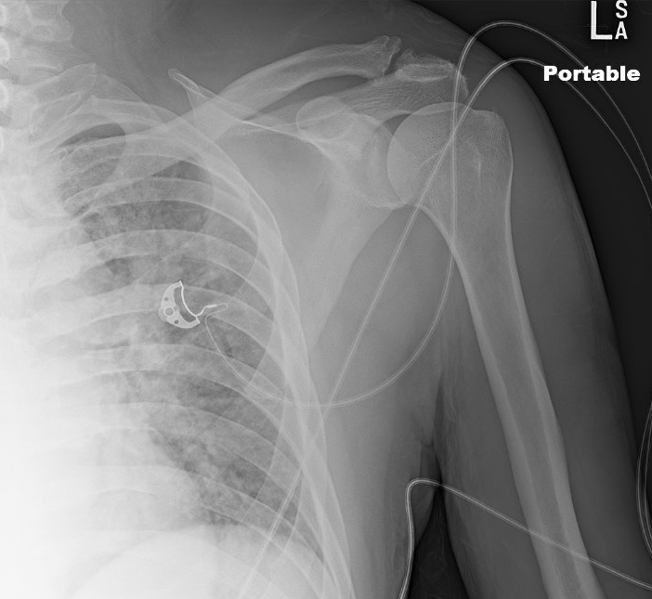
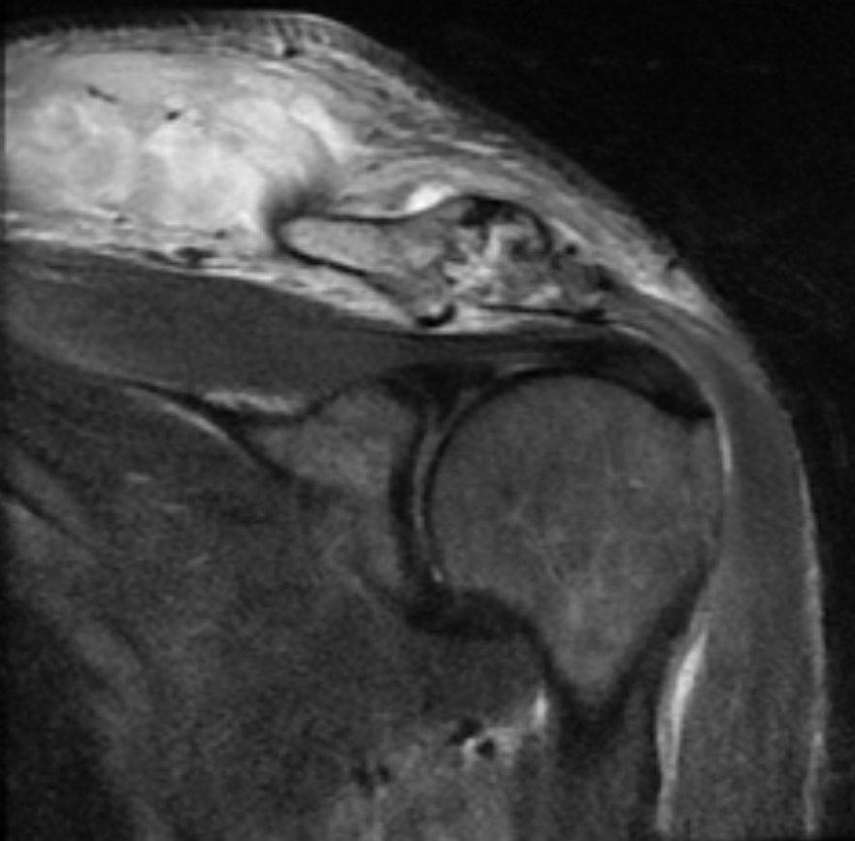
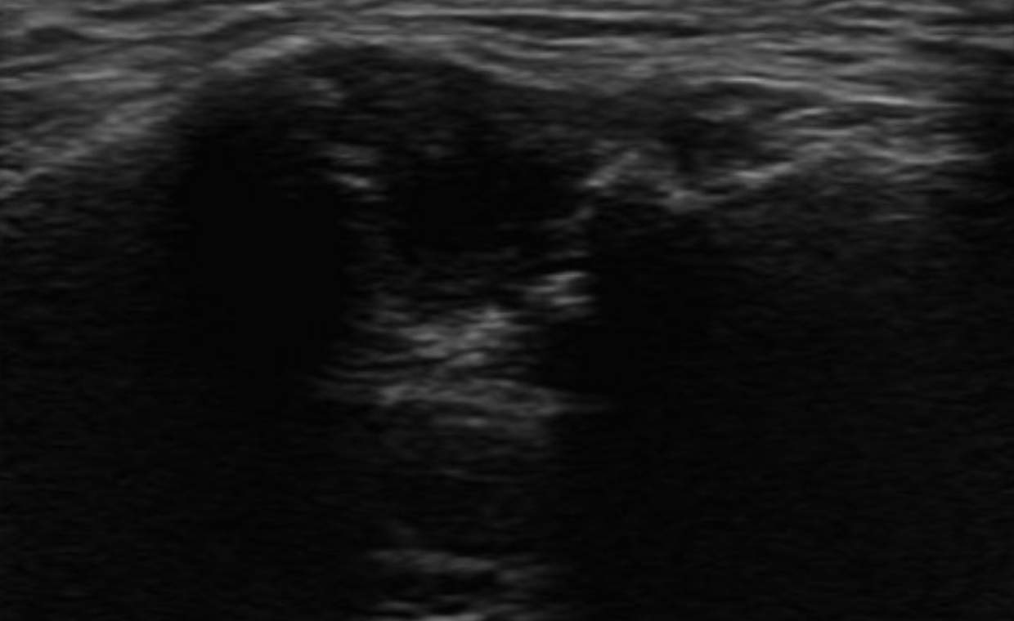
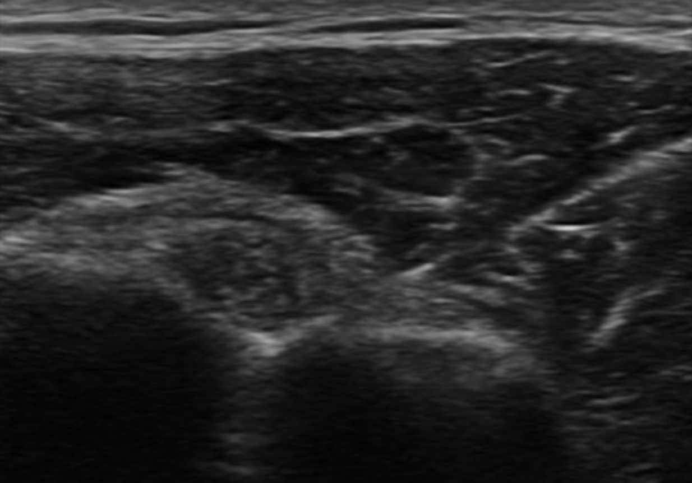
My Lovely Shoulder Lumps: A Case of Shoulder Pain, Check It Out!
Nha Truong DO/MPH, Derrick Nguyen DO, Samnisola George MD, Tri Mai MD, Uziel Sauceda MD
RUHS/UCR Sports Medicine Program
CASE DESCRIPTION
OBJECTIVE
FINAL WORKING DIAGNOSIS
52 M with PMHx of HTN, DM (Hb A1C 9.8%), diabetic foot ulcers, and alcohol abuse presents to Emergency department w/ left shoulder pain, right hip pain and right foot pain.
+ recurrent falls 2/2 alcohol intoxication with LOC 2 days prior to presentation.
Left shoulder pain is located at the base of neck over the trapezius and extends to the posterior aspect of the left shoulder and feels like it is “going to fall out of place”.
R Hip pain mainly in the posterior aspect and has been able to ambulate but with a limp.
He denies IV drug use. Last drink was on day of presentation.
IMAGING:
XR Left Shoulder: Moderate AC
joint degenerative changes
MRI of left shoulder:
1) AC joint arthrosis with joint
space fluid and articular surface
erosions. Marrow edema throughout surrounding acromion and clavicle. Possible fluid collection along superior periosteal surface of the distal clavicular mid epiphysis
2) Extensive edema in left visualized trapezius
3) Extensive edema in posterior aspect of deltoid muscle with probable 2.5 cm complex fluid collection along its deep margin and involving adjacent infraspinatus and teres minor muscles as well as teres major muscle.
4) Subcutaneous edema over the shoulder most notably the superior and posterior aspects
5) Mild supraspinatus tendinopathy. No rotator cuff tear.
Left deltoid pyomyositis with abscess
Left AC joint arthritis (suspected septic- neg culture)
Complicated MSSA bacteremia
RIght hip adductor pyomyositis with abscess
Right hallux osteomyelitis
TREATMENT COURSE
Outcome:
I&D of left shoulder abscess with orthopedics
Surgical findings: Did not see gross evidence of infection in AC joint, but noted palpable induration over proximal trapezius and posterior shoulder abscess deep to deltoid
CT guided aspiration of L deltoid abscess and R hip adductor group done post op.
R partial 1st ray amputation given osteomyelitis findings
TEE negative for endocarditis.
Treated with 6 weeks IV antibiotics (Cefazolin) from date of first negative blood culture.
Discharged and went to acute rehab.
Follow up:
Completed IV abx course, negative CRP/ESR on follow up with orthopedics with improved ROM.
Completed physical therapy
Followed up with orthopedics, sports medicine, infectious disease and pain management.
Due to persistent pain post infection, received CSI of Left GH joint and biceps tendon.
Last sports medicine visit 3/2/22, left shoulder pain noted to have resolved.
PHYSICAL EXAM
Vitals: HR 120, BP 151/94, Temp 100.4F, SpO2 94%
GEN: Alert, NAD, intermittently sleepy but arousable
Heart: Tachycardic, regular rhythm, no murmurs
Lungs: CTAB, no c/w/r, normal effort
Abdomen: Soft, non-TTP, no guarding, no rebound
Left Upper Extremity Exam:
Skin: no open wounds, lesions, scars. Subtle erythema around base of L neck overlying trapezius extending to superior aspect of L shoulder. Forearm compartment soft.
MSK: TTP over L lateral aspect of neck over trapezius and posterior aspect of L shoulder, Minimal TTP of anterior shoulder. Abduction 45 degrees, flexion 25 degrees with severe pain at the end of ROM. Normal digits ROM and strength
Neuro: No sensory deficit dermatomes C5-T1
Vasc: Radial pulse palpable, cap refill <2 sec
Erosions seen at the distal clavicle (blue arrow) and pericapsular fluid collection within the trapezius (yellow arrows)
Ultrasound:
Visualized is the AC joint (AC)
with degenerative changes
ACJ
DIFFERENTIAL DIAGNOSIS
DISCUSSION
Left shoulder pyomyositis (trapezius, deltoid, rotator cuff)
Left AC joint septic arthritis
Left rotator cuff tendinosis vs tear
Left AC joint osteoarthritis
Labral tear
Ultrasound guided CSI:
Needle (N)
injection seen
within the
bicipital groove
(G), adjacent to
the long head
of the biceps
tendon (BT)
Septic joint arthritis is a diagnosis that cannot be missed due to its potential life-threatening nature. Etiologies include seeding of joint from bacteremia, trauma or surgery, or contiguous spread secondary to adjacent osteomyelitis. Most common pathogen is staph aureus. Treatment is emergent surgical irrigation and debridement followed by directed IV antibiotics. This case likely had a hematogenous source with various sites of seeding (shoulder, hip, toe). It is unclear as to etiology of bacteremia, though uncontrolled diabetes was a risk factor.
N
OBJECTIVE
LABS: Hematology: WBC 8.4, Neut 83.2%, lymph 8.6%, mon 7.7%, eosin 0.3%, baso 0.2%, Hgb/hct 11.1/32.7, MCV 100.8, INR 1.3, ESR 130, CRP 27.2, Glu 559, Na 132, Cr 1.8, Alb 2.3, ALP 118, UDS +THC and opiates. Blood culture: MSSA. Left shoulder phlegmon culture: MSSA. AC joint culture: no growth. Right thigh abscess culture: MSSA.
BT
BG
REFERENCES
Orthobullets.com. 2022. Septic Arthritis - Adult - Trauma - Orthobullets. [online] Available at: <https://www.orthobullets.com/trauma/1058/septic-arthritis--adult> [Accessed 20 March 2022].
Uptodate.com. 2022. UpToDate. [online] Available at: <https://www.uptodate.com/contents/septic-arthritis-in-adults> [Accessed 20 March 2022].
Steinmetz RG, Maupin JJ, Smith JN, White CB. Septic arthritis of the acromioclavicular joint: a case series and review of the literature. Shoulder & Elbow. 2020;12(4):272-283. doi:10.1177/1758573218815289

